Slide 1
Health Insurance Lead Prediction

Slide 2
Problem Statement

Slide 3

Descriptive Statistics And EDA

Slide 4
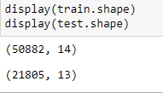
Understanding the dataset
Total there are two datasets
1) Train.csv
2) Test.csv
Dimension of dataset

Slide 5
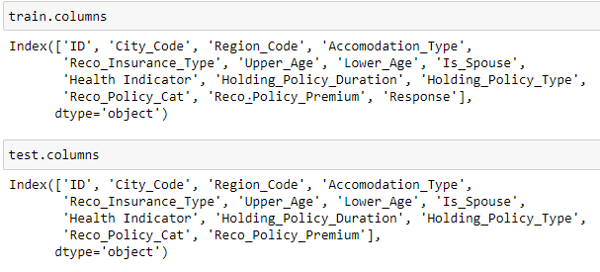
Columns in both datasets
The only difference between the two datasets is the ‘Response’ column as in testing phase we will be predict response of the customers.

Slide 6
Finding Unique Values
We will use info() function for datatype, count and other parameters .
Also we nunique() functions helps us to find out the total unique values as it can be further classifies as numeric, ordinal or categorical.

Slide 7
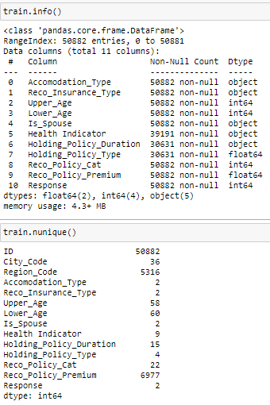
Train dataset

Slide 8
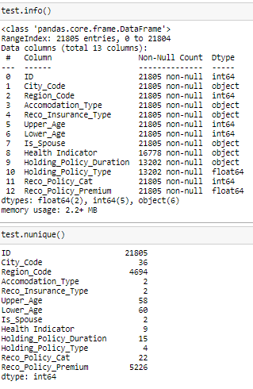
Test dataset

Slide 9
Breakdown of variables
As we can see from the output we can easily identify the variables and which category they can be used.
Variable | Type
Accomodation_Type | Categorical
Reco_Insurance_Type | Categorical
Upper_Age | Numeric
Lower_Age | Numeric
Is_Spouse | Categorical
Health Indicator | Categorical
Holding_Policy_Duration | Numeric
Holding_Policy_Type | Categorical
Reco_Policy_Cat | Categorical
Reco_Policy_Premium | Numeric

Slide 10
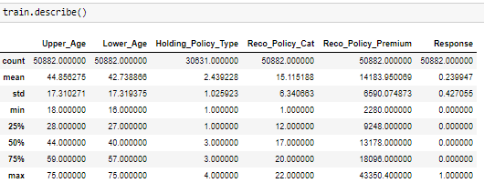
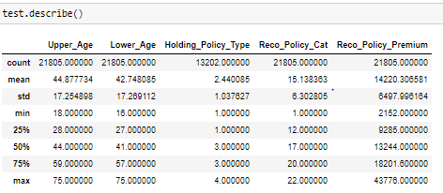
Summarising Statistics

Slide 11
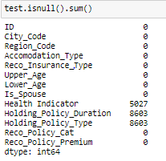
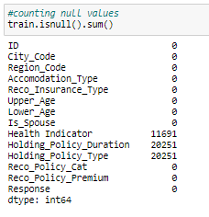
Identifying Null/missing Values
For Train dataset
For Test dataset

Slide 12

Dropping Unwanted features
We have dropped ID, City_code and Region_code from both the datasets.

Slide 13
Outliers

Slide 14
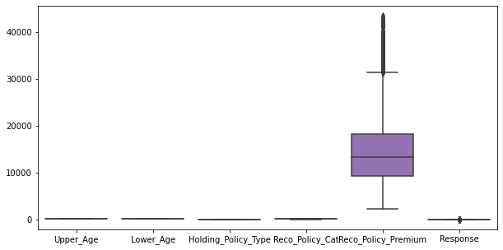
Reco_policy_premium is the only variable having the highest outliers as we can seen from the box plot.

Slide 15
Visualization

Slide 16
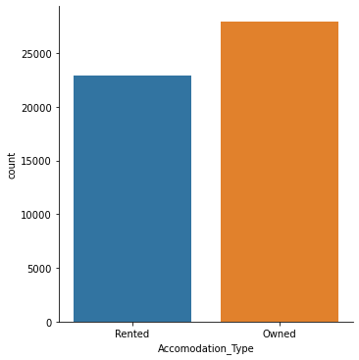
Accomodation_type plot

Slide 17
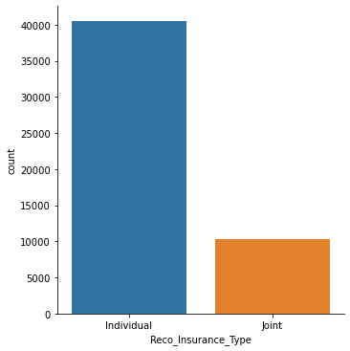
Reco_Insurance_Type plot

Slide 18
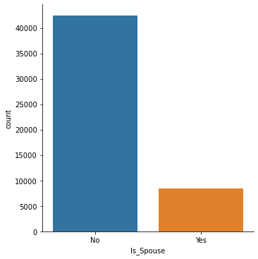
Is_Spouse plot

Slide 19
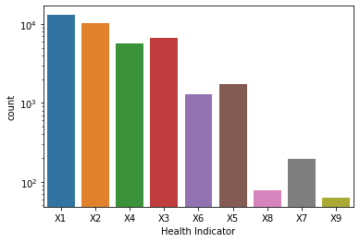
Health Indicator plot

Slide 20
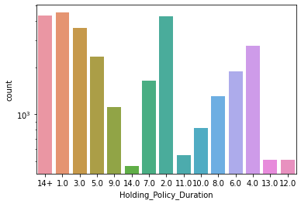
Holding_Policy_Duration plot

Slide 21
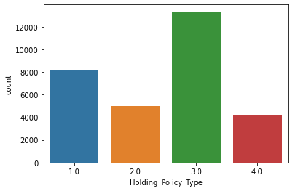
Holding_Policy_Type plot

Slide 22
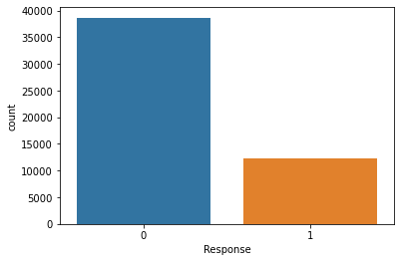
Response plot

Slide 23
GitHub link for Jupyter notebook
https://github.com/yashbhavsar98/Health-Insurance-Lead-Prediction

